Slide 1
Note App
ITCC 107
Group 5

Slide 2

PROBLEM
Without a note app, it's harder to organize thoughts and information efficiently. This can lead to wasted time searching for misplaced notes or trying to recall details that could have been easily referenced, ultimately decreasing productivity.
Relying on paper notes or memory increases the risk of losing important information. Paper can be misplaced, damaged, or lost, and trying to remember everything without a reliable system can lead to crucial details being forgotten.
Limited offline access hinders productivity, as users are unable to edit or view their notes when internet connection is unavailable.
Many people struggle to remember important details, such as tasks, appointments, or ideas, leading to missed deadlines, forgetfulness, and disorganization.

Slide 3
SOLUTION
Our Note App offers a unified platform for organizing notes, ensuring easy access and seamless synchronization across devices.
With offline access capabilities, users can continue to work on their notes even without an internet connection, with changes syncing automatically once they're back online.
Enhanced security measures, including encrypted cloud storage options, provide peace of mind, ensuring the privacy and protection of users' data.
Set up notifications and reminders within the note app to alert users about upcoming tasks, appointments, or deadlines.

Slide 4
People
Student: They use note apps to take class notes, organize study materials, and track assignments.
Employer: Employers use note apps to manage meetings, record tasks, and collaborate with team members.
Normal People: Everyday users use note apps for lists, reminders, journaling, and creative writing.
Kids: Children use note apps for learning, homework, and creative expression.

Slide 5
Activities
Users need a quick way to jot down ideas, tasks, reminders, and other information.
It is for Single User that can create, organize and access their own notes without interaction or interference from others.
It can use the app in mobile phone an it can be used in offline.
the app can be use in all ages.

Slide 6
Context
Student use note taking apps for lectures, research, studying, and organizing class material.
can be interactive on different screen sizes.
can be use in offline.
Professionals use note-taking apps to keep track of meeting, projects, task, and important information related to their jobs
can install in their mobile devices.
suitable for public areas

Slide 7
Technology
Apps The suitable use for different types of ages.
It can be used in mobile phone or tablet.
Very simple to use.
Flutter framework.
Dart Programming.
Flutter Hive.
User should be able to access and edit their notes even when they’re offline.

Slide 8
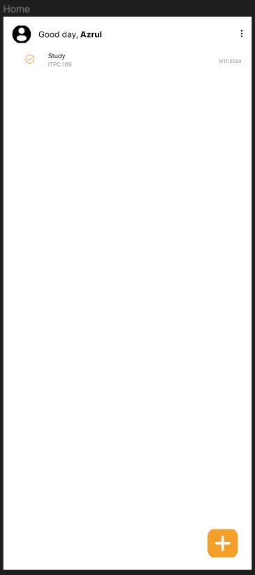
HOME: The Note App is like a home for your notes, where you can keep all your thoughts and ideas organized and easily accessible from your phone or tablet.

Slide 9
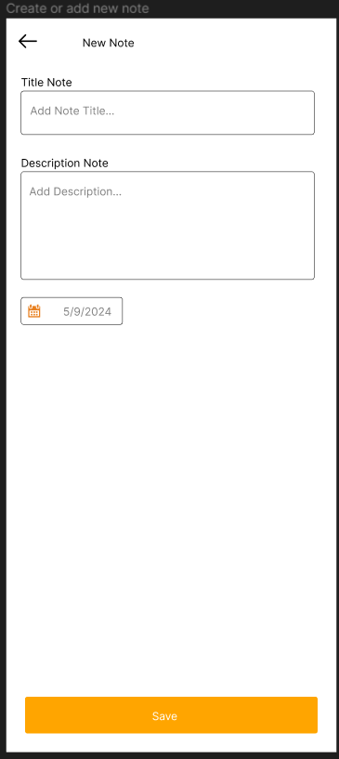
Add new note: The Note App is like a cozy home for your thoughts and ideas, where you can easily add new notes with just a few taps or clicks, keeping everything organized and accessible whenever you need it.

Slide 10
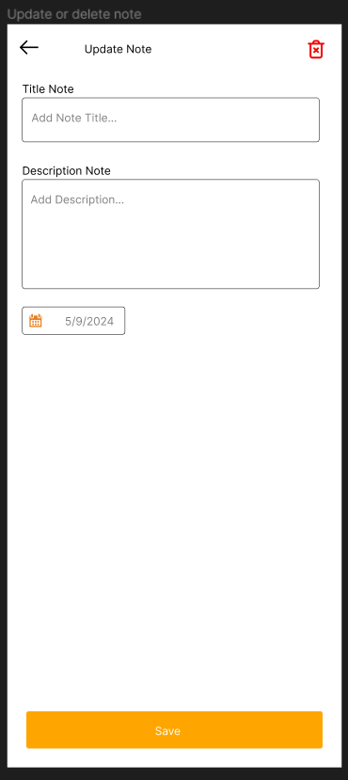
Update or delete note: The Note App is your personal space where you can not only add new notes but also easily edit or delete them whenever you need to, ensuring your ideas stay up-to-date and clutter-free.

